Slide 1
Google Assistant Home
Presented By :
Ashwani Madhukar (201880010)
Jatin Sharma (201880024)
Aniket Kumar (201880003)
Dhruv Kumar (201880017)

Slide 2
Content
Introduction
General Working Flow
Components
Hardware
Software
IFTTT
Adafruit.io
Android App (Firebase)
Reference

Slide 3
Introduction
Google Assistant Home(GAH) is a working model of controlling known electronic appliances.
User will control via voice command and android phone.
Google Assistant
IOT
GHA
IFTTT
Adafruit.io

Slide 4
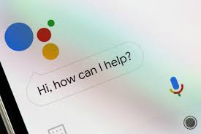
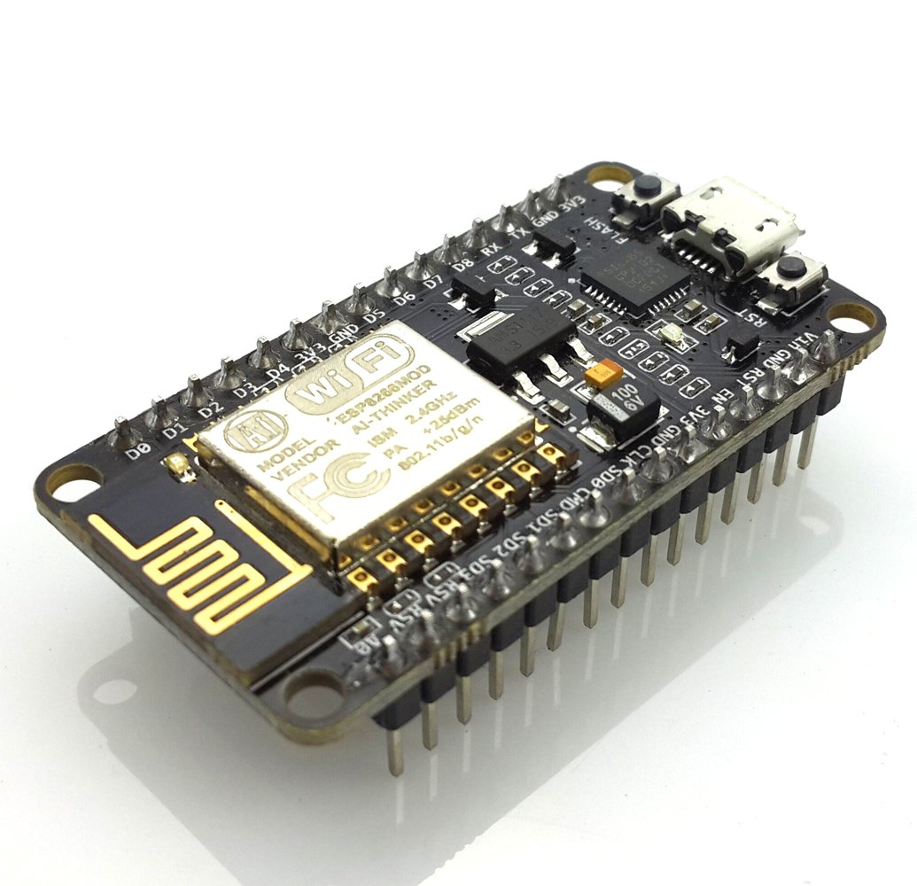
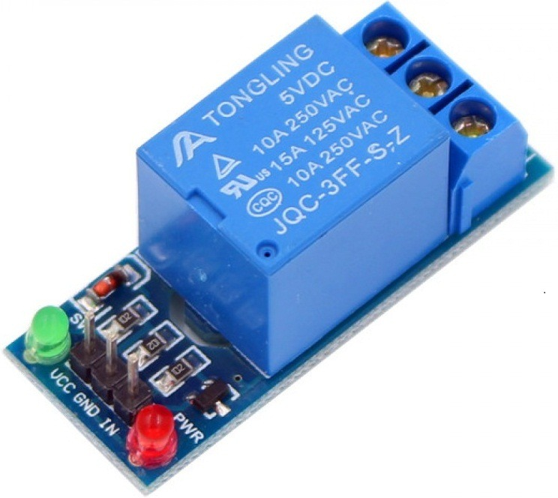

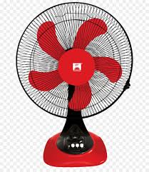
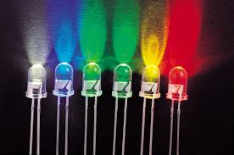
General Working Flow

Slide 5
General Working Flow
Google
Assistant
Relay
Mobile
Node MCU
Fan
Bulb
LED

Slide 6
Components
Components
Hardware
Node MCU
Relay Board
Software
Arduino IDE
Bread Board
Breadboard power supplier(5V)
IFTTT
Android app
Adafruit

Slide 7
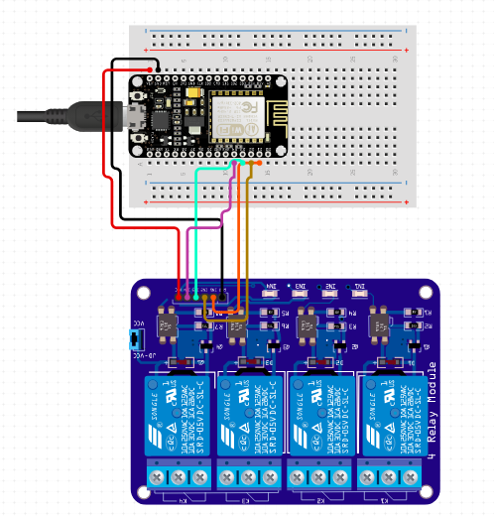

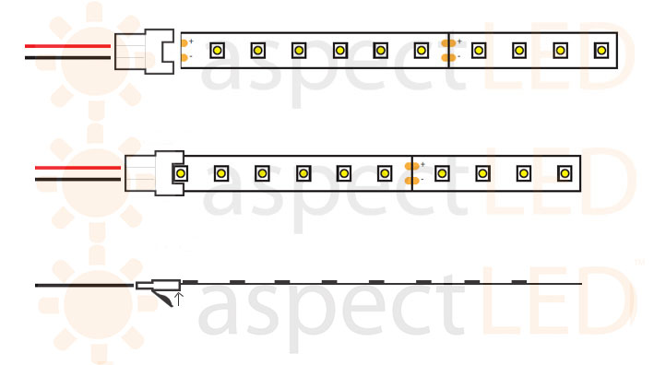

Configuration

Slide 9
IFTTT
slogan: put the Internet to work for you.
automation service for all your internet-connected things.
Connect all your services using Applets.
It currently supports more than 360 services.

Slide 10
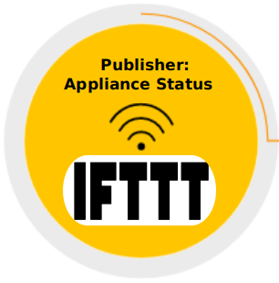

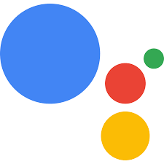
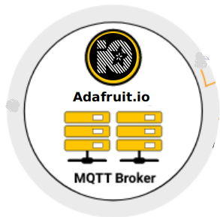
Working
Mobile

Slide 11
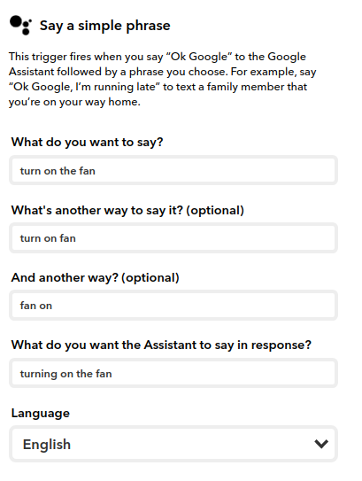
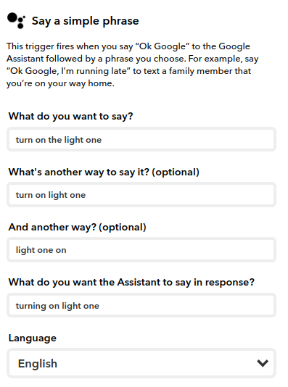
Configuring the IFTTT Applet
For Fan
For Light

Slide 12
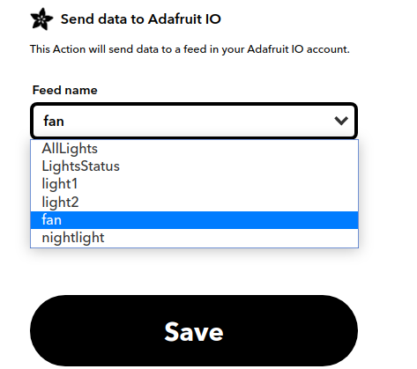
After feeding IFTTT, sending data to Adafruit IO

Slide 13
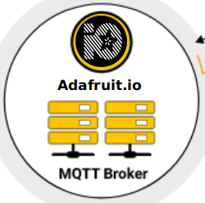

Slide 14

It supports MQTT protocol.
Designed to display, respond, and interact with your project's data in real-time, online.
It can handle and visualize multiple feeds of data.
A cloud service platform.
Integration with IFTTT and Zapier
It connects your project to other internet-enabled devices.
Adafruit.io

Slide 15
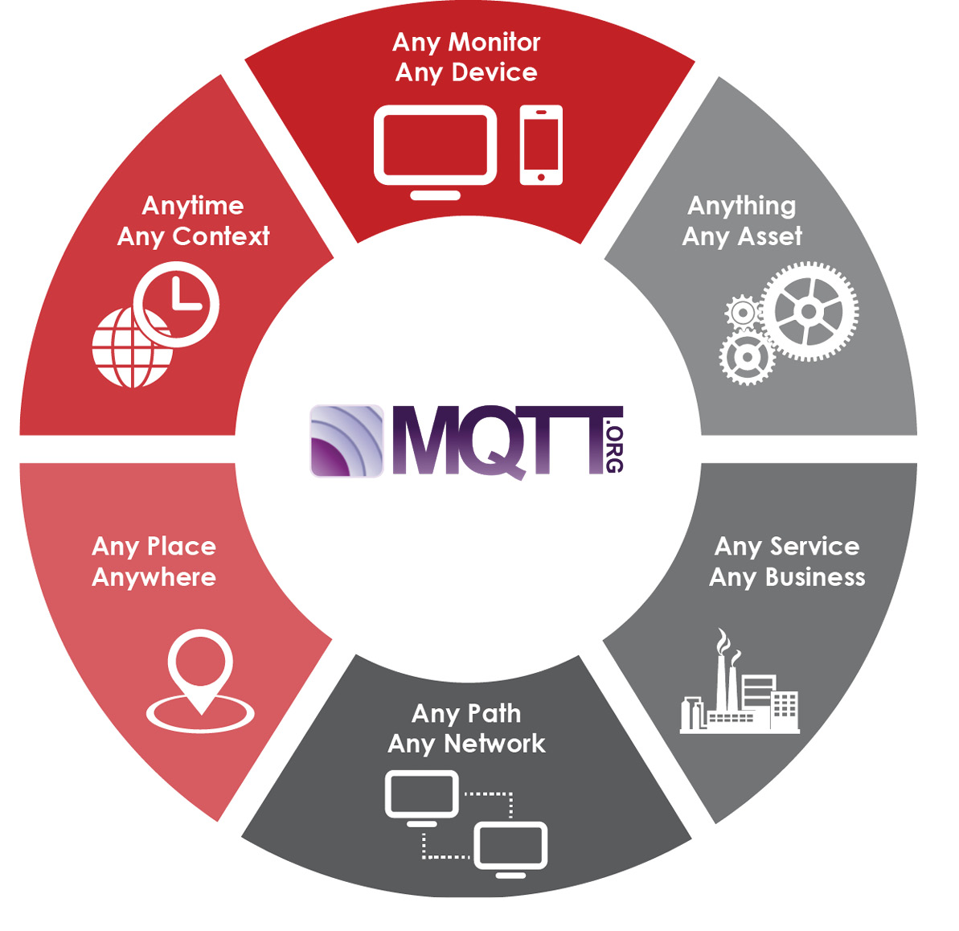
It is a Client Server publish/ subscribe messaging transport protocol.
used for communication in Machine to Machine (M2M) and Internet of Things(IoT).
Lightweight and bandwidth efficient.
Simple implementation
message queue telemetry transport

Slide 16
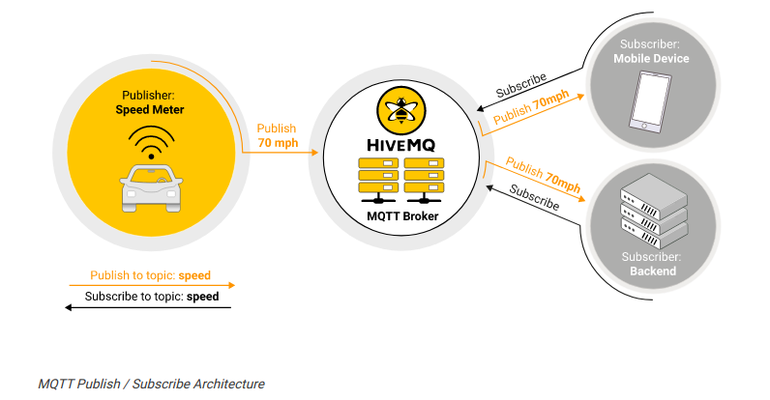
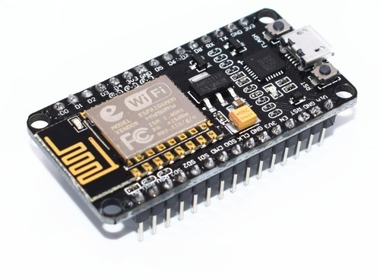

Working principle of the project using Adafruit.io
Subscriber:
Node MCU
Publisher:
Appliance Status
Publish ON/OFF
Publish
ON/OFF
Adafruit.io
Publish to feeds : Appliances
Subscribe to feeds: Appliances

Slide 17
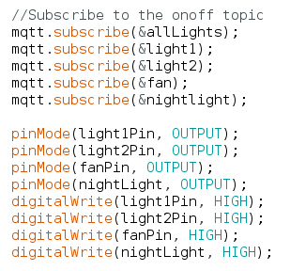
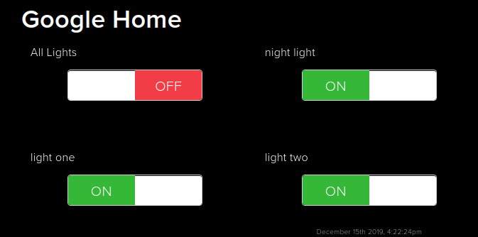
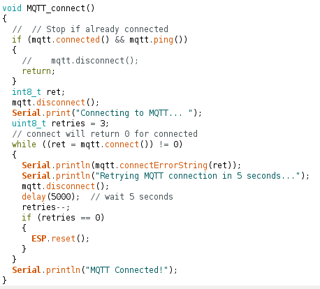
Adafruit FEEDS
Connect

Slide 18
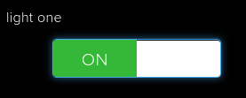
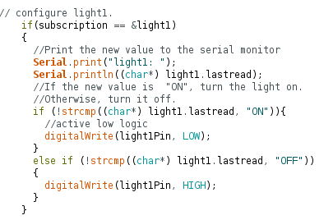

Light One Feed
ON
OFF

Slide 19
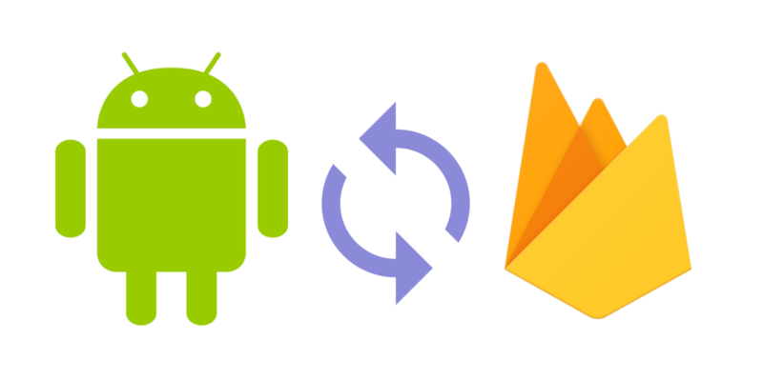

Slide 20
Controlling Appliances using Android
This project helps the user to control all the electronic devices using smart phone.
The system implements wireless Android technology to provide remote access from smart phone.
The design replaces the existing electrical switches and provides more safety control on the switches.

Slide 21
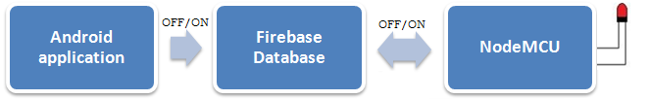
Working principle of the project Using Android app
Steps1: The Android app sends the serial data 1 or 0 to the Firebase database.
Steps2: The Firebase database interacts with Wi-Fi NodeMCU and this NodeMCU acts on the basis of data received from Firebase Database.
Steps3: If NodeMCU receives serial data 1, it turns ON the LED, and if NodeMCU receives serial input 0 then it turns OFF the LED.

Slide 22
Advantages
The main advantages of Controlling appliances through Android Mobile is that the physically Challenged and Disabled People can use easily.
Fast access
low cost design
Easy installation

Slide 23
Development Platforms
Android Studio
Android is an open source and Linux-based Operating System for mobile devices
Features
Connectivity
Storage
Media support
Multi-tasking

Slide 24
Firebase (DB)
Firebase is a mobile and web application development platform developed by Firebase. Firebase is a Backend-as-a-Service — BaaS platform for building Web, Android and IOS applications. It offers real time database, different APIs, multiple authentication types and hosting platform. cured connection to Firebase servers.
Features
Real-time Database: Firebase supports JSON data and all users connected to it receive live updates after every change.
Authentication − We can use anonymous, password or different social authentications.
Hosting − The applications can be deployed over se

Slide 25
Why we Use firebase in our project?
Firebase provides a quick way to keep sensory data collected at the device level, and it works great with the Android APIs, which is supported by Android.
The data is real-time, which means that every change will automatically update connected clients.
Firebase offers simple control dashboard.
There are a number of useful services to choose.
It is simple and user friendly. No need for complicated configuration.

Slide 26
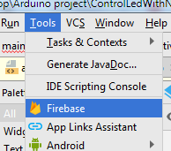
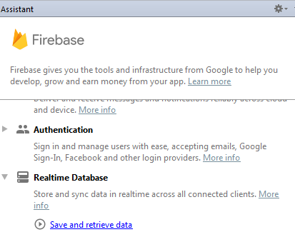
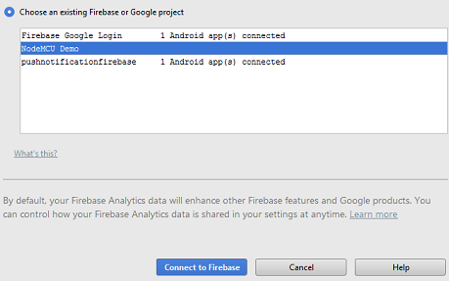
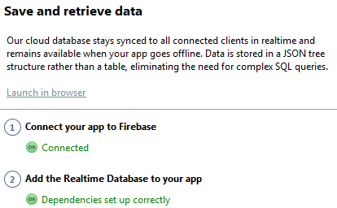
Connectivity of firebase with Android
Open Android Studio and create an Empty project.
First of all, we need to connect our Android app with Firebase project.
For doing this click Tools > Firebase > Click Realtime Database > Save and retrieve data.
Click on the option "1 Connect your app to Firebase" and select your project created over Firebase.
After selecting project, click "Connect to Firebase", and add "Realtime Database to your app"

Slide 27
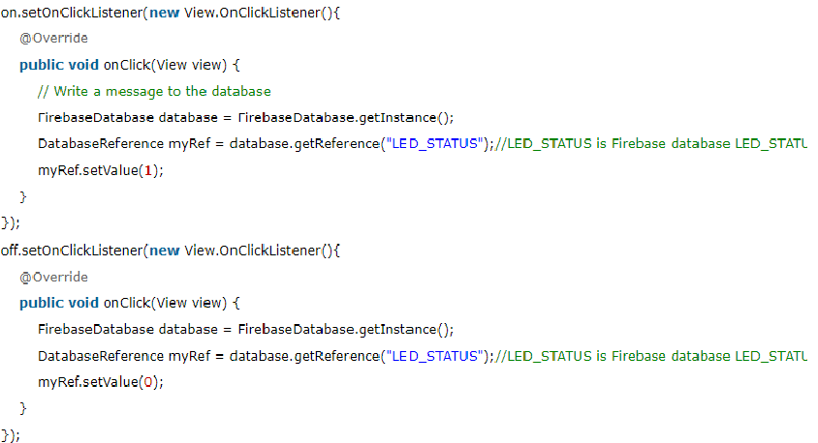
Coding

Slide 28

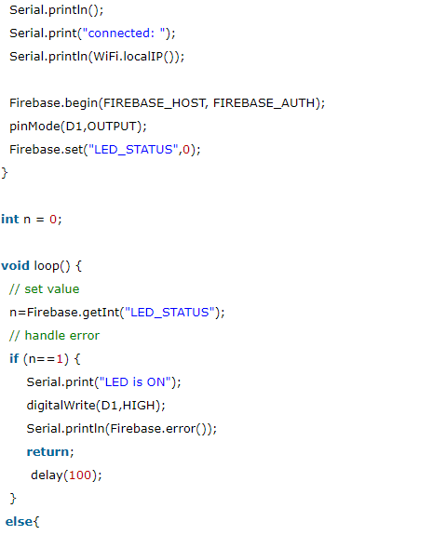
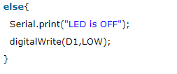
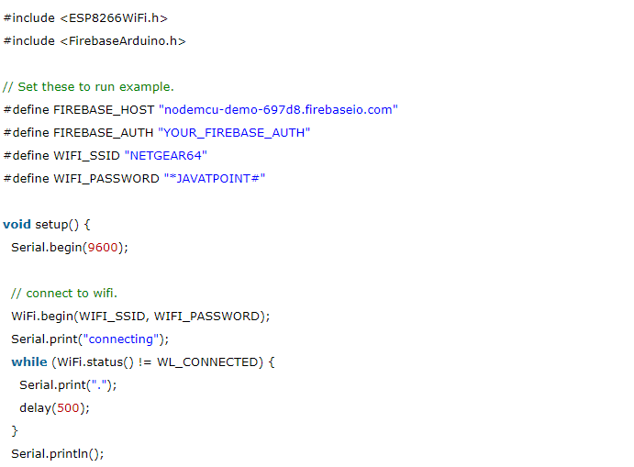
“******”*

Slide 29
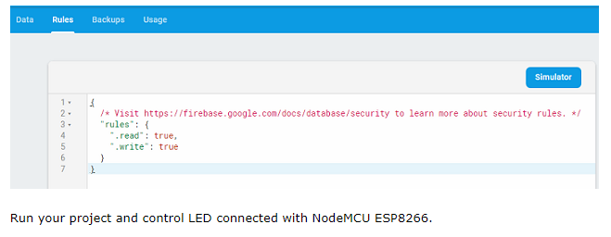

Slide 30
References
https://www.arduino.cc/en/main/software
https://ifttt.com/
https://io.adafruit.com/
https://codeometry.in/nodemcu-and-google-assistant/
https://www.hackathon.io/firebase
https://github.com/adafruit/Adafruit_MQTT_Library
https://github.com/mobizt/Firebase-ESP8266
https://nodemcu.readthedocs.io/en/master/

Slide 31
ANY QUESTIONS ?

Slide 32
THANK YOU

